Slide 1
Lorain County Juvenile Court Assessment and Resource Center

Slide 2
Hours of Operation
7 days a week
12:00 pm (noon) – 12:00 am (midnight)
Closed on holidays
Assessments will not be started after 11:00 p.m.

Slide 3
Location: 1070 Infirmary Rd, Elyria

Slide 4
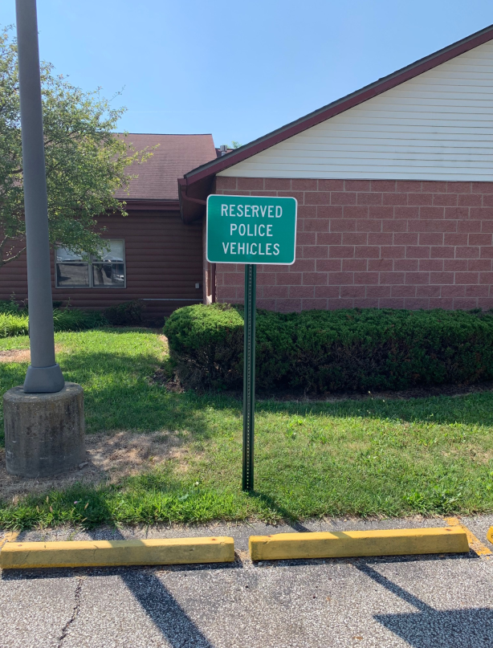
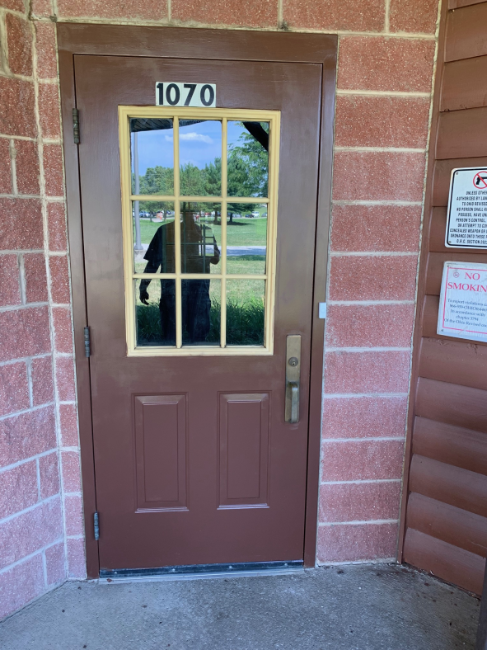
Reserved Parking
Entrance, ring doorbell

Slide 5
The What and Why of the Lorain County Juvenile Court Assessment and Resource Center…
A Juvenile and/or family can (voluntarily) receive assistance with unruly and/or delinquent behaviors.
A center that focuses on juveniles receiving assessments and early interventions.
A place that gathers and distributes information on available community resources.
Families can receive information on community resources.
Juveniles/parents will receive recommendations.

Slide 6
You could utilize the Assessment Center when…
If a juvenile is not accepted into the Detention Home or Turning Point, the Assessment Center may be utilized.
If you are not asking for the juvenile to be detained in the DH or placed at TP but believe immediate attention is necessary, the Assessment Center may be utilized.
Note: Please continue to follow the same/normal protocol that has been utilized for Detention Home or Turning Point requests.

Slide 7
You could utilize the Assessment Center when… (Cont.)
If the juvenile does not need immediate attention but an assessment, resource, or other assistance would help the juvenile or the family with the juvenile’s unruly or delinquent behaviors, refer the family to the Assessment Center.
Note: juveniles, parents, and law enforcement officers will NOT be turned away.
Please use officer discretion.

Slide 8
Use Officer Discretion
Law enforcement will not be turned away; however, not all juveniles need to be taken to the Assessment Center.
Appointments and/or referrals are encouraged.

Slide 9
Expectations of officer’s reasonable efforts regarding contact with parent/guardian.
When bringing a juvenile to the center, please contact the juvenile’s parent/legal guardian/responsible adult.
All reasonable efforts must be made (phone call, home visit, etc.).
Please advise the parent to meet you at the Assessment Center to pick up their child within an hour or Children Services may be contacted.
If the parent/responsible adult is unable to be at the center within an hour, the parent/legal guardian must contact the center to make other arrangements.

Slide 10
Intake Process
Criteria
Under 18 y/o
Must have an offense (unruly, DV, drug offense, assault, etc.)
Must be medically cleared if under the influence of any substance
Must be medically cleared if actively suicidal or self-injurious. (see next slide)
Must make contact with the Assessment Center prior to transport.
Must identify parent/guardian to report to the Assessment Center within one hour
Option “A”
Call the control room @ 440-326-4041.
The call will be screened to confirm if the DH, Turning Point, or Assessment Center is appropriate.
If requesting the Assessment Center, your call will be directed to one of the Assessors.

Slide 11
If the juvenile is demonstrating suicidal/homicidal/self-injurious behaviors or ideations, contact The Nord’s ESS Center or transport to the emergency room before bringing to the Assessment Center.

Slide 12
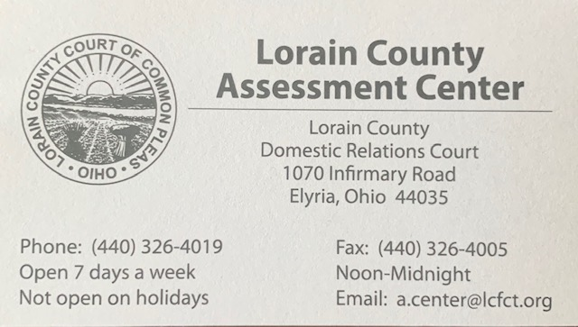
Intake Process
Option “B”
Provide the parent/guardian with a business card in order for them to schedule an appointment:
After hours and on holidays.
If the juvenile does not need immediate attention.

Slide 13
Intake Process
Upon arrival, any belongings from the previously searched juvenile will be transferred to an Assessment Specialist.
Officers will complete the notice of incident form and Juvenile Rule 6 form.

Slide 14
Intake Process
Forms completed by officers

Slide 15
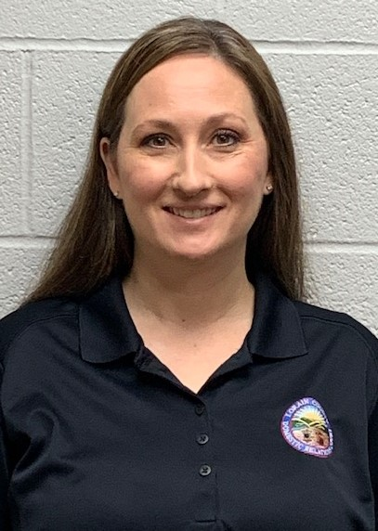
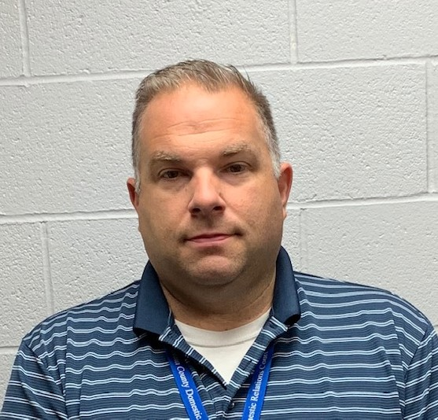
Assessors
Heather Rider, Program Manager
440-326-4019
heather.rider@lcfct.org
a.center@lcfct.org
Jim Rufo, Assessment Specialist
440-326-4095
jim.rufo@lcfct.org

Slide 16
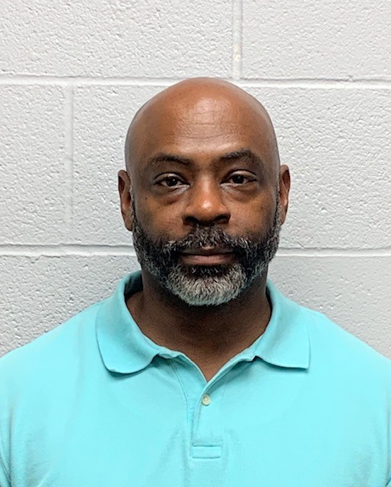
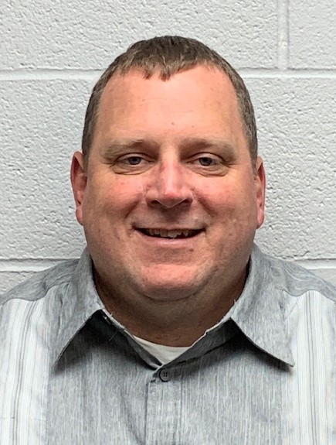
Assessors
Jerome Fisher, Assessment Specialist
440-326-4094
jerome.fisher@lcfct.org
Jim Carroll,
Assessment Specialist
440-326-4093
jim.carroll@lcfct.org

Slide 17
Key Points
Juveniles only need to be medically cleared if they appear under the influence, injured, or displaying significant mental health symptoms.
Officer shall contact parent/guardian and instruct them to contact Assessment Center.
Juvenile must be searched.
Your input is appreciated.

